Slide 1
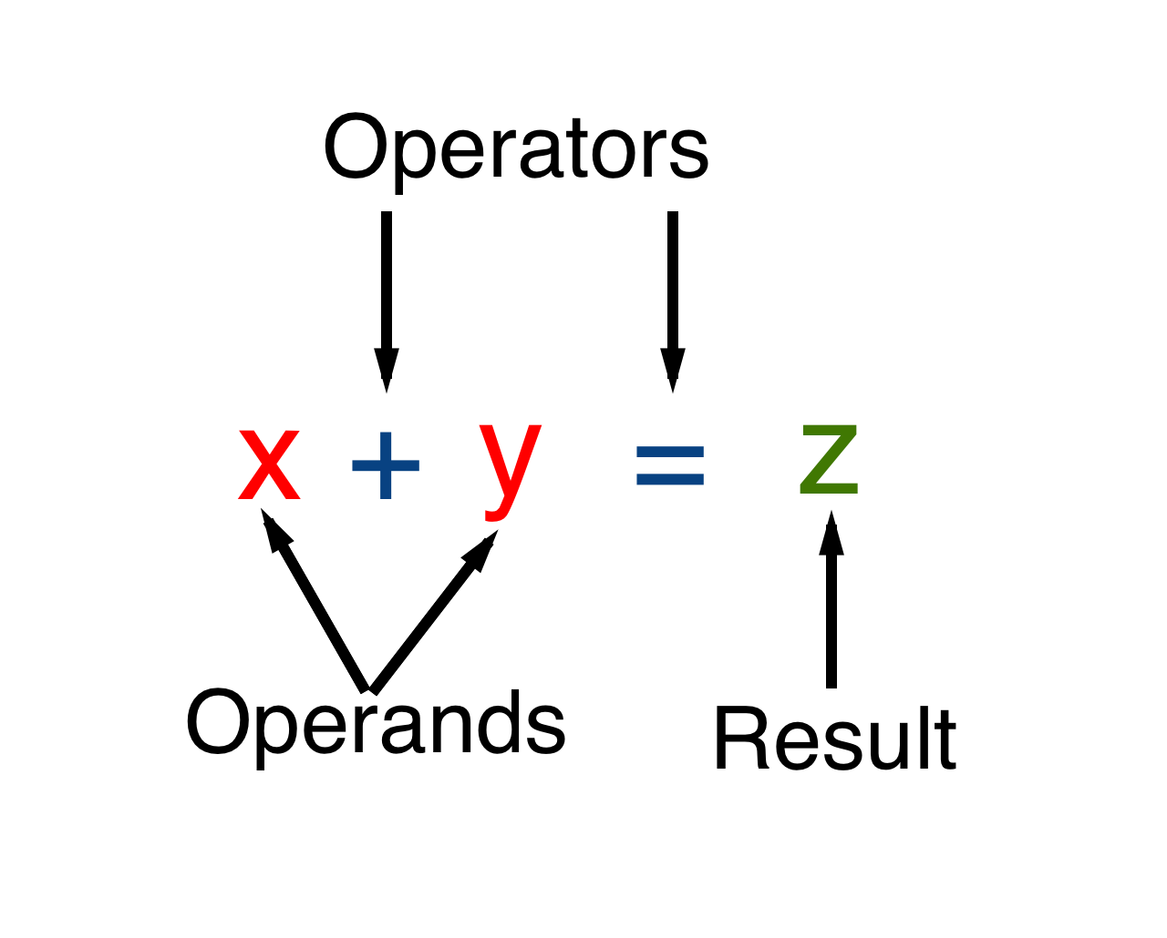
EXPRESSIONS
An Expression is a collection of operators and operands that represents a specific value.
In the above definition, operator is a symbol which performs tasks like arithmetic operations, logical operations and conditional operations etc.,
Operands are the values on which the operator's perform the task. Here operand can be a direct value or variable or address of memory location.
Example :

Slide 2
TYPES OF EXPRESSIONS
PRIMARY EXPRESSIONS
POSTFIX EXPRESSIONS
PREFIX EXPRESSIONS
UNARY EXPRESSIONS
BINARY EXPRESSIONS
TERNARY EXPRESSIONS

Slide 3
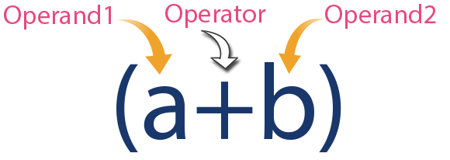
PRIMARY EXPRESSIONS
The Expression in which Operator is used in between Operands is called Infix Expression or Primary Expression.
The infix expression has the following general structure :
Operand1 operator operand2
Example :

Slide 4
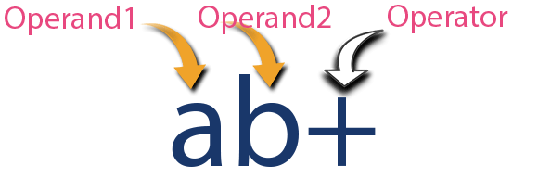
2. POSTFIX EXPRESSIONS
The expression in which operator is used after operands is called as Postfix Expression.
The postfix expression has the following general structure :
Operand1 operand2 operator
Example:

Slide 5
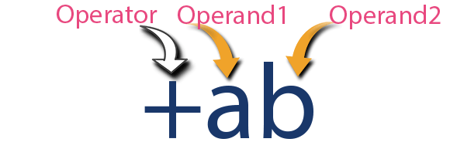
3. PREFIX EXPRESSIONS
The expression in which operator is used before operands is called as Prefix Expression.
The prefix expression has the following general structure :
Operator operand1 operand2
Example :

Slide 6
4. UNARY EXPRESSIONS
Unary means operation is performed on one operand.
Example : ++a, a++, a--, --a etc.,
5. BINARY EXPRESSIONS
Binary means operation is performed on two operands.
Example : a+b, a*b, a++b, a--b etc.,

Slide 7
6. TERNARY EXPRESSIONS
The ternary operator is an operator that takes three arguments .
The first argument is a comparison argument.
The second is the result upon a true comparison.
And the third is the result upon a false comparison.
Example : exp1 ? exp2 : exp3
Where exp1, exp2 and exp3 are the expressions.
? and : are the ternary operators.

Slide 8
PRECEDENCE & ASSOCIATIVITY
Precedence of operators :
If more than one operators are involved in an expression, C language has a predefined rule of priority for the operators.
This rule of priority of operators is called operator precedence.
Priority Levels:
First priority : Parenthesis i.e., ( ), [ ], { }
Second Priority : *, / , %
Third Priority : +, -

Slide 9
Example of precedence
The Expression is : (1 > 2 + 3 && 4)
This expression is equivalent to: ((1 > (2 + 3)) && 4) i.e, (2 + 3) executes first resulting into 5 then, first part of the expression (1 > 5) executes resulting into 0 (false) then, (0 && 4) executes resulting into 0 (false)
Output :
0

Slide 10
Associativity of operators :
If two operators of same precedence (priority) is present in an expression, Associativity of operators indicate the order in which they execute.
Example of associativity is : 1 == 2 != 3
Here, operators == and != have same precedence. The associativity of both == and != is left to right, i.e, the expression on the left is executed first and moves towards the right.
Thus, the expression above is equivalent to :
((1 == 2) != 3) i.e, (1 == 2) executes first resulting into 0 (false) then, (0 != 3) executes resulting into 1 (true)
Output :
1

Slide 11
Rules for evaluation of expression
First parenthesized sub expression left to right are evaluated.
If parenthesis are nested, the evaluation begins with the innermost subexpression.
The precedence rule is applied in determining the order of application of operators in evaluating sub expressions.
The associability rule is applied when two or more operators of the same precedence level appear in the sub expression.
Arithmetic expressions are evaluated from left to right using the rules of precedence.
When Parenthesis are used, the expressions within parentheses assume highest priority.
Note: Precedence of operators decreases from top to bottom in the given table.

Slide 12
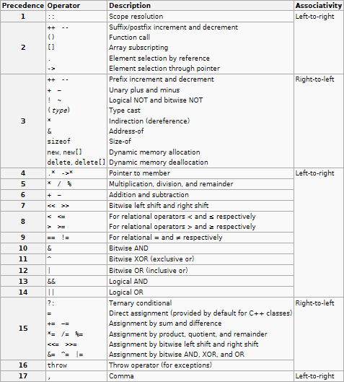
Summary of C operators with precedence and associativity

